Slide 1
Functional Classification Review
KYTC
Division of Planning

Slide 2
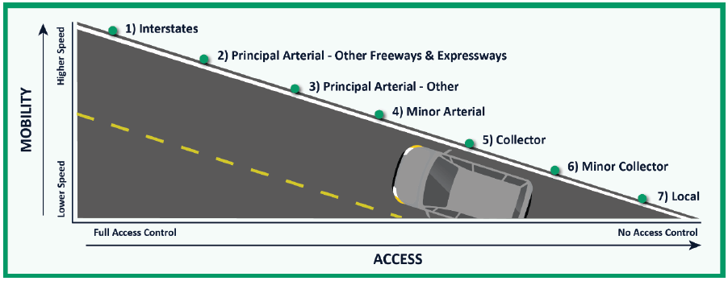
Functional Classification
Describes the function a road plays in serving the flow of traffic through a highway network
It is the road’s primary purpose that defines the functional class category that it is assigned

Slide 3
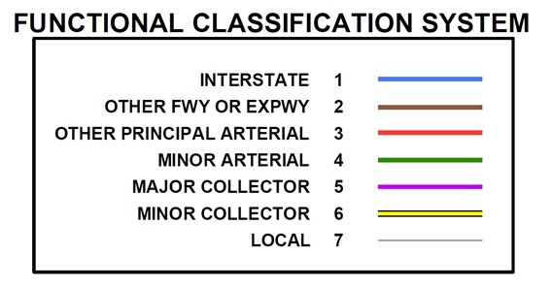
Federal Aid eligibility
Roads are eligible for federal funding if they fall within functional classes 1 to 5 or 6 in an Urban area
The review of Urban Area Boundaries and Functional Classification can impact the federal aid eligibility of roads.
This gives stakeholders incentive to participate in the review.
We want to make sure that federal funds are allocated appropriately.

Slide 4
Federal Aid eligibility
Rural
Urban
Principal Arterial
Interstate | Interstate
Other Freeway and Expressway | Other Freeway and Expressway
Other Principal Arterial | Other Principal Arterial
Minor Arterial
Minor Arterial | Minor Arterial
Collector
Major Collector | Major Collector
Minor Collector | Minor Collector
Local
Local | Local
 | = Federal Aid Eligible

Slide 5
Review
Generate data, maps etc. for use by local planning partners (MPOs, KYTC Districts and local officials)
Deliver data and documents to local planning partners
Work with planning partners during the review process
Gather and review all Functional Classification changes
Submit changes to FHWA for approval
Once approved, incorporate changes into HIS

Slide 6
Review

Slide 7
Review
Tentative Timeline:
Start Spring of 2025
Have all changes from planning partners due Fall 2025
Have all changes to FHWA for approval December 1st
Hope to have all changes approved by end of 2025

Slide 9
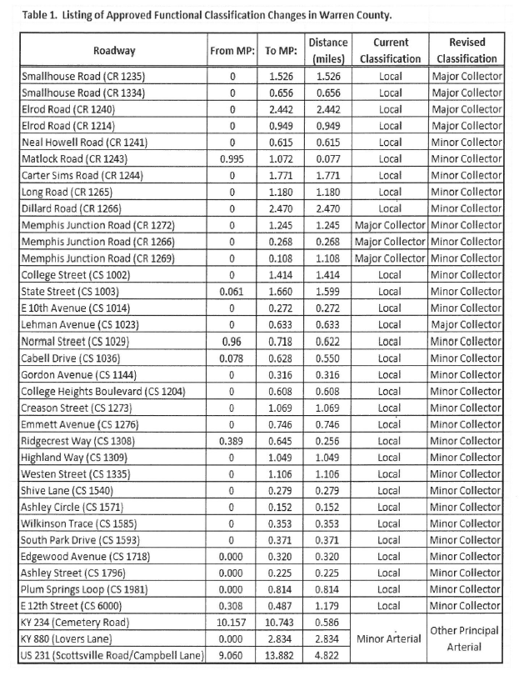

Slide 10
Links
FHWA – Highway Functional Classification Concepts, Criteria and Procedures: 2023 Edition
KYTC Functional Classification Homepage

Slide 11
Questions?

